Slide 1
Single Cell Deconvolution
Neha Mane - 111491083
Rahul Bhansali - 111401451

Slide 2
Content
Biological Overview
Estimation of immune cell content in tumour tissue using single-cell RNA-seq data
BSEQ-sc: Deconvolution of Bulk Sequencing Experiments using Single Cell Data
CIBERSORT

Slide 3
What is Deconvolution?
Resolve into constituent elements and remove complication to clarify it
Mathematically - the resolution of a convolution function into the functions from which it was formed in order to separate their effects
Notes:
Explain matrices and f*g = h

Slide 4
Deconvolution in terms of biology
Identify constituent cell types and gene expression profiles in a tissue and their relative proportions
Heterogeneous tissues - difficult to get the precise gene expression levels for each cell type.
Biological conditions like diseased state vs non-diseased state also affect cell proportions

Slide 5
Expression level in genes
Genes encode proteins and proteins dictate cell function.
Genes expressed in a particular cell determine what that cell can do.
Can be used to separate cell types and tissues.
In linear model - the expression of each gene in a complex mixture is estimated as a linear combination of the expression of the same gene in the constitutive cell types.
Deconvolution to estimate cell-type-specific expressions and the percentages of each cell type.

Slide 6
Computational vs experimental methods
Computationally - Deconvolution - less effort and expensive
Experimental cell separation techniques like FACS - time, effort and expense is high
May result in insufficient RNA for further quantification of gene expression

Slide 7
Estimation of immune cell content in tumour tissue using single-cell RNA-seq data
Summary
Derive cellular composition from bulk gene expression data by deconvolution using Reference Gene Expression Profiles (RGEPs).
Consensus Profiles for each cell type used for Deconvolution.
Distinguish 9 major cell types and 3 T-cell sub-types.
Origin and quality of RGEP determine deconvolution results.

Slide 8
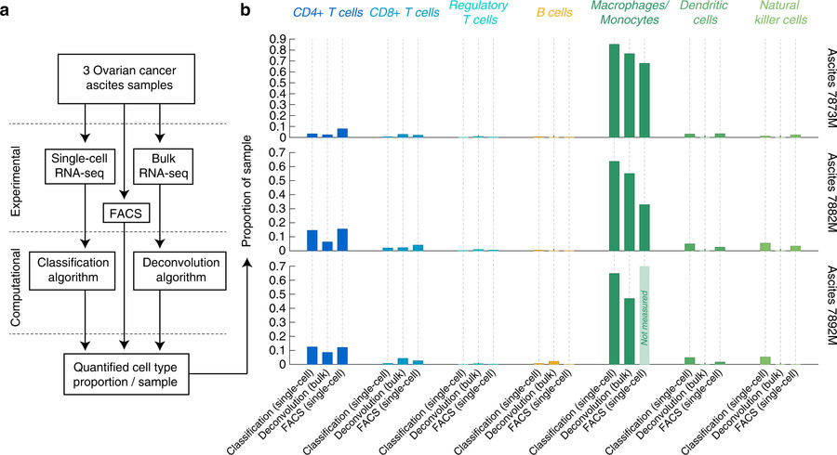
Method

Slide 9

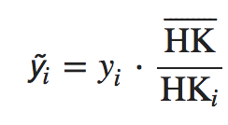
Method 1 - Single-cell
Take log of Gene expression value (unit: TPM):
2. Normalize:
Where y i represents the gene expression profile of the ith sample and
HK represents the gene expression profile of the housekeeping genes

Slide 10
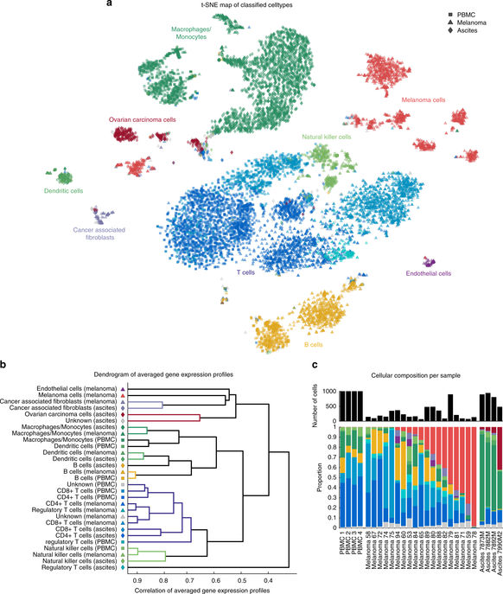
Method 1 (Continued)
3. Dimensionality Reduction and Clustering:
Apply t-SNE mapping on merged gene set to reduce to two dimensions and DBSCAN for clustering.
4. Classify each cell to a cell type:
Scores calculated based on a set of 45 marker genes (AND, OR, NOT) and classified if score> 75% of maximal score.

Slide 11
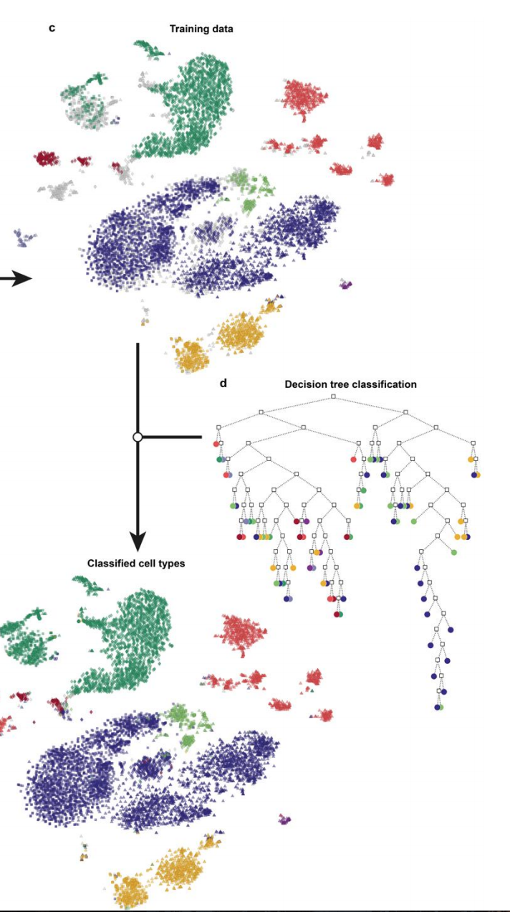
Method 1 (Continued)
5. Train Classifier to categorize major cell types:
A Decision Tree classifier was trained based on single-cell RNA seq. data
5-fold cross-validation accuracy of 98%
6. Same process repeated for classifying sub-types of T cells (Accuracy: 93%)

Slide 12
Method 2 - Bulk RNA-seq
Construct “Bulk” Gene Expression Data:
Aggregate reads from single-cell RNA sequencing data for each patient sample.
2. Construct Signature Gene Set:
LM22 (547) + Table S12 (244) + Table S3 (391) + 45 marker genes.
Call this the Merged Gene Set.

Slide 13
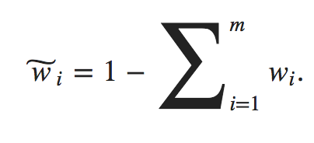
Method 2 (Continued)
3. Apply Deconvolution Algorithms:
v-SVR (Support Vector Regression): Combines feature selection with a linear loss function and L2-regularization. Used libSVM of MATLAB.
fitlm: fits a linear model based on a least-squares fit.
SDPT3 algorithm: Semidefinite-quadratic-linear programming.
4. Estimating Results:
where, w̃ is the unknown cell proportion.
m is the no. of known cell type proportions.

Slide 14
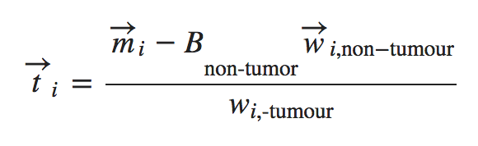
Method 2 (Continued)
5. Estimation of quality assessment:
Pearson’s correlation coefficient calculated for true cell proportions v/s estimated proportions.
6. Tumour gene expression profile estimation:
where: mi is the patient’s known bulk gene expression;
B is the total non-tumour gene expression for the patient.

Slide 15
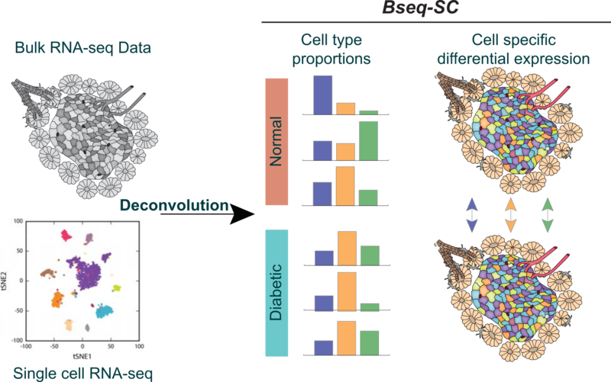
BSEQ-sc: Deconvolution of Bulk Sequencing Experiments using Single Cell Data

Slide 16
BSEQ-sc: Deconvolution of Bulk Sequencing Experiments using Single Cell Data
Overview:
Single cell RNA-seq information is used to deconvolve bulk RNA-seq samples by estimating the cell-type proportion of key cell-types.
Estimate average cell-type specific expression in healthy v/s diabetic groups of individuals and to compute cell type-specific differential expression.
Investigate gene expression differences between diabetics and healthy individuals, using single cell RNA-seq data.
Gene expression may vary solely based on the cell type proportions. So, the proportions are adjusted to obtain “real” differentially regulated genes.

Slide 17
Method
Data Generation:
Bulk Gene Expression Data: Obtained from GEO dataset
Counts from transcripts that map to a single cell was averaged.
Single-Cell Data: Single-Cell RNA Seq. Data of pancreatic islets from 3 healthy individuals.
Identify cell-type by clustering.
Extract Marker genes for each cell type. (most highly expressed genes).
Average each marker gene for each cell type.
Scale.
Data Preparation:
Used ExpressionSet objects from Bi-conductor base package for single-cell and bulk data
Bulk data
filtered to remove unmapped tags
glycemic groups were defined based on hba1c measurements
Single cell data
Identify cell types by clustering and extract marker genes from each cell-type

Slide 18
Method (Continued)
3. Estimation of Cell-Type Proportions:
Build reference basis matrix from single cell gene expression:
Scale single-cell count data.
Compute average, within each cell type, the gene expression of each marker gene for each cell in the cell type.
CIBERSORT:
Estimate cell type proportions using the bulk gene expression data and reference basis matrix.
4. Estimation of differentially regulated genes at cell type level:
EdgeR package used.
Two models fitted

Slide 19
Method (Continued)
5. Base Model:
Includes HBA1C groups (Diabetic, Normal), Gender and Age variables.
6. Extended Model:
a. Additionally includes proportions of alpha, beta, ductal and acinar cells.
7. Estimation of differentially regulated genes:
Adjust for cell type proportions.
Apply fitEdgeR utility function to fit Base and Extended Models. (p-val=0.01)
The “likely” genes are obtained.

Slide 20
Method (Continued)
8. Apply csSAM on above selected genes and 6 ER stress related genes.
csSAM fits a linear model based on cell proportions and cell-type.
ER genes were upregulated (FDR=0.05). Alpha and Acinar cells responded mildly.
On downregulation (FDR=0.25), Beta cells responded strongly.
Strongest responding genes were filtered for each cell type and their effect-size graph was plotted.

Slide 21
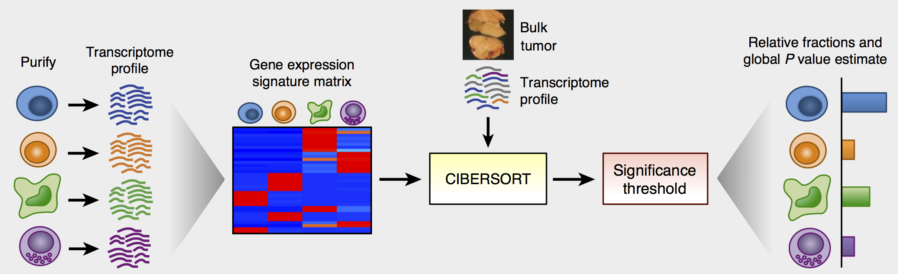
CIBERSORT
Applied for estimating cell-type proportions from bulk gene expression data.
Robust to noise, unknown mixture content and closely related cell types.
Gene set of 547 genes (LM22) used for deconvolution.
An application of linear support vector regression(SVR) is used to deconvolve the mixture.

Slide 22
THANK YOU

